Slide 1
Simple Shooter
Part 2
by TommyX

Slide 2
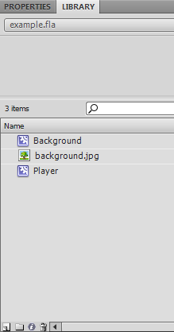
Creating Objects Using Code
Lets first create our bullet object and store it in the library.
Aside from drawing things on stage and converting them into Symbols, we can create symbols and modify them directly.
Click here to create a new symbol.

Slide 3
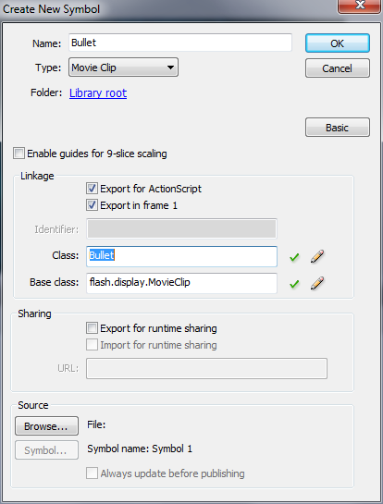
Creating Objects Using Code
Setup our new Symbol, give it a library name.
In order to create this Symbol using code at runtime, we need to specify another name for the Symbol: the Class name. Check “export for ActionScript”, and give it a class name.
This name does not have to be different from Library name, but must be unique for each type of symbol.

Slide 4
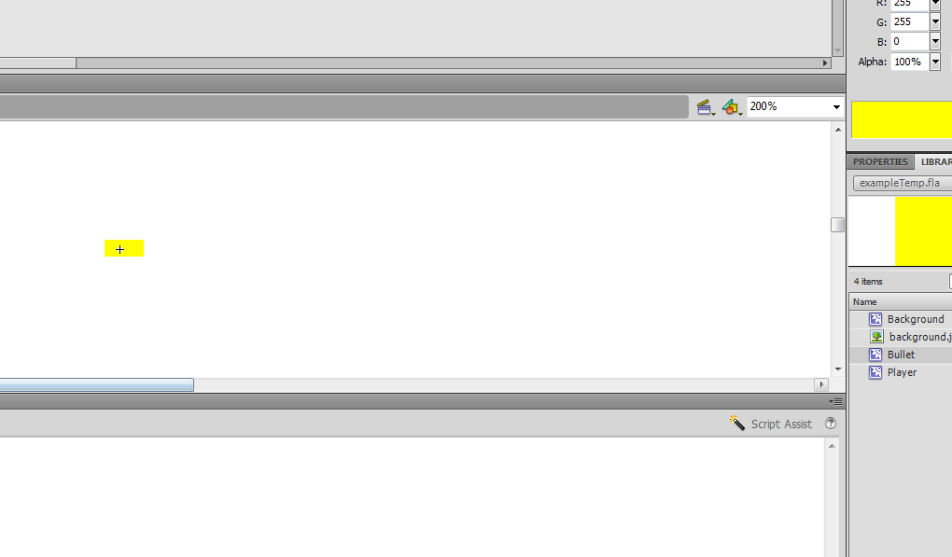
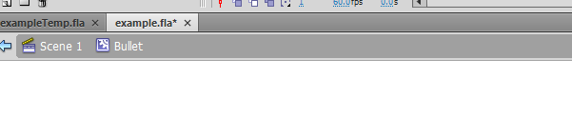
Creating Objects Using Code
Draw the shape or place the image of the bullet.
Click here to go back to stage.

Slide 5
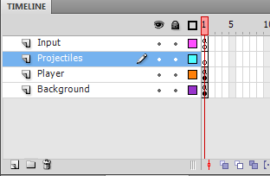
Creating Objects Using Code
Lets create a new layer to manage our projectiles such as bullets or power-ups.
Then, click on the frame of that layer to change the code.
Click here to create a new layer.
Double click to change layer name. Drag to arrange them.

Slide 6
Creating Objects Using Code
Because we will be spawning our bullets multiple times, lets put the spawning code inside a function. We will only pass in the position for the bullet for now.
function spawnBullet(posX:Number, posY:Number){
}

Slide 7
Creating Objects Using Code
The Class name we gave for the bullet Symbol can actually act like a type of variable. So we will create a variable with the type “Bullet” (class name of bullet symbol).
function spawnBullet(posX:Number, posY:Number){
var bullet:Bullet = new Bullet()
bullet.x = posX
bullet.y = posY
}
The “new” keyword followed by the class name and a empty bracket is called a constructor. This line of code will create a new bullet object, which is stored under the variable name bullet.
We will initialize its position using the parameters.

Slide 8
The Display List Structure
Flash has a unique structure to manage objects that are being drawn on screen. This structure is called the Display List.
There are 2 main types of object associated with displaying.
DisplayObject: These are objects that contain information about shapes or images, which can be drawn directly on screen. Think of them as Files in your computer.
DisplayObjectContainer: These are objects that act as containers for DisplayObject. They contains no graphical information, only a list of DisplayObject. The order of items in the list determines which DisplayObject is drawn first. This list can also contain DisplayObjectContainer, which makes order arranging even easier. Think of them as Folders in your computer.

Slide 9
The Display List Structure
Here is an example of a display list structure:
(DOC-DisplayObjectContainer)
(DO-DisplayObject)
-root(DOC)
-backgroundLayer(DOC)
-backgroundObject(DOC)
-backgroundImage(DO)
-playerLayer(DOC)
-playerObject(DOC)
-playerShapes(DO)
-projectileLayer(DOC)
-bulletObject1(DOC)
-bulletImage(DO)
-bulletObject2(DOC)
-bulletImage(DO)
-bulletObject3(DOC)
-bulletImage(DO)

Slide 10
The Display List Structure
When Flash draws the screen, the final image consists of the following in order:
-backgroundImage(DO)
-playerShapes(DO)
-bulletImage(DO)
-bulletImage(DO)
-bulletImage(DO)
The Flash always have a root container. When you are on the frames of the stage timeline, you are working with the root container.
MovieClip Symbols we have created are Containers, not DisplayObjects. We put images IN them, but themselves don’t contain graphical info. Nevertheless, they can be in the display list and acting like a display object.

Slide 11
Creating Objects Using Code
The previous code only created the object, but it is not on the display list yet. To add it into the display list, we use the container’s function addChild.
function spawnBullet(posX:Number, posY:Number){
var bullet:Bullet = new Bullet()
bullet.x = posX
bullet.y = posY
addChild(bullet)
}
Since we are on the main timeline, we are implying that we are adding bullet to the root container’s display list. To add a display object to another container, write for example “container2.addChild(stuff)”.

Slide 12
Making loop function for objects
To animate the object, it is better to have make the object have its own loop function, AKA enterFrameHandler. We can write a function inside the spawn function, and add an event listener on the bullet (not the root).
function spawnBullet(posX:Number, posY:Number){
var bullet:Bullet = new Bullet()
bullet.x = posX
bullet.y = posY
addChild(bullet)
function loop(event){
}
bullet.addEventListener(Event.ENTER_FRAME, loop)
}
Because in ActionScript 3.0, variables and functions are only available in certain range, in this case, inside the function scope. The variable bullet and function loop cannot be called outside of this spawn function, therefore we don’t have to worry about name conflicts.

Slide 13
Making loop function for objects
Lets make the bullet move with some speed to the right.
function spawnBullet(posX:Number, posY:Number){
var bullet:Bullet = new Bullet()
bullet.x = posX
bullet.y = posY
addChild(bullet)
var speed:Number = 5
function loop(event){
bullet.x += speed
}
bullet.addEventListener(Event.ENTER_FRAME, loop)
}

Slide 14
Removing Object from the stage
The object can’t stay on stage forever. Lets remove the object after it moves out of the visible area.
If the bullet’s x position is greater than width of stage, first remove it from the display list, then remove its event listener because we no longer want to loop its code.
function spawnBullet(posX:Number, posY:Number){
var bullet:Bullet = new Bullet()
bullet.x = posX
bullet.y = posY
addChild(bullet)
var speed:Number = 5
function loop(event){
bullet.x += speed
if (bullet.x > stage.stageWidth){
bullet.parent.removeChild(bullet)
bullet.removeEventListener(Event.ENTER_FRAME, loop)
}
}
bullet.addEventListener(Event.ENTER_FRAME, loop)
}

Slide 15
Shooting bullets
Lets setup the space bar key in the input layer.
The keycode for spacebar is 32.
if (event.keyCode == 32) {
keySpaceDown = true
}
//…etc
After setting up the input, we can add the shooting in the code of player layer.
if (keySpaceDown){
spawnBullet(player_mc.x, player_mc.y)
}
//…etc
We will talk about rate of fire, collision detection etc in later lessons.

